Slide 1


EMBEDDED LINUX

Slide 2
What is linux
Linux commands
Files editors & permissions
Loops & shell scripting
Networking in linux

Slide 3

Linux is the biggest open source project

Slide 4
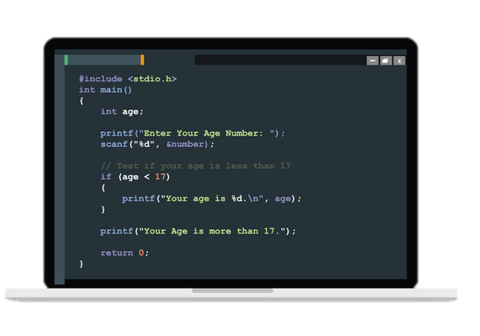
95% of Linux is in C

Slide 5
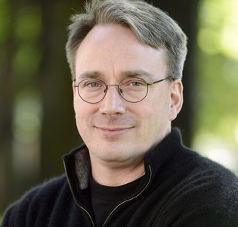




Introduction to Linux
Linux is a Unix-like OS developed by Linus Torvalds
& thousands of opensource contributors
September 17, 1991

Slide 6
Introduction to Linux
Operating System
Open Source
Reliable & Secure

Slide 7




Introduction to Linux
Most of Hardware support linux OS

Slide 8


Introduction to Linux
Windows vs Linux
Licence we need to buy. And as depending upon the requirement expense varies. | Free Licence.
Less Customization. | Comparatively more. And we can create our own linux kernel.
Anti virus is required required to protect kernel | More secure Kernel.

Slide 9




Introduction to Linux
Distributions

Slide 10
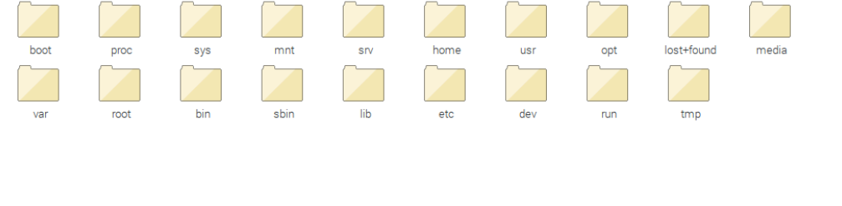
Directory in Linux
bin : essential user commands
etc : configuration files for system
sbin : essential system binaries
usr : read-only user application support data & binaries
var : variable data files
dev : device files
home : home directory
lib : library & kernel
mnt : mount files for temporary filesystems
proc : process & kernel info files
root : home dir for root user
opt : optional software applications

Slide 11

LINUX SHELL

Slide 12
Basics of Shell
Hardware
Kernel
Shell
Application
Linux Architeccture
Calculator
ls
cp
grep
pwd
file manager

Slide 13
KERNEL

Slide 14

Basics of Kernel
It is Computer program which is the core interface which connect the Hardware to software.
KERNEL

Slide 15
Basics of Kernel
Operations by Kernel
Resource Management - Decides which process gets a resource for an operation
Memory management - Kernel has complete access to system memory and must efficiently manage it and allow memory access to processes
Device management - If we connect devices such as a printer or a pen drive, kernel detects it and helps the system establish connection with those peripherals
System calls – This is an interface between a process and the operating system. When the process does not have permissions to access a resource, a system call provides it without the process accessing the resource directly

Slide 16
Basic Linux Commands
Commands | Task
pwd | Shows the present working directory
cd | To change folder
cp | Used to copy a file
rm | To delete a file
date | Gives the date and current time Shows
clear | Clears the entire terminals content
man | It is a guide to the commands
whoami | Gives the current username

Slide 17
Basic Linux Commands
touch
ls
cat
mv
echo
exit
bash
!pw
expr

Slide 18
Variable

Slide 19
Set & Unset
The set command is a built-in function in bash and few other cells which you can use to define the values of system variables. Set is not required to set a variable, there are various ways to do it.
export command is used to create Environment variables
The unset command is a built-in function in bash which you can use to remove a variable which is set

Slide 20
Shell Script

Slide 21
Shebang (#!)
#! – This represents which interpreter a script should be interpreted with
#!/bin/bash - This is a header command which represents it is a bash/shell script
#!/bin/bash is this is not provided it often considers #!/bin/sh which would be same in most cases. When you put #!/bin/bash in your script, even if you run the script in a different shell,the kernel will know which shell to interpret it with

Slide 22
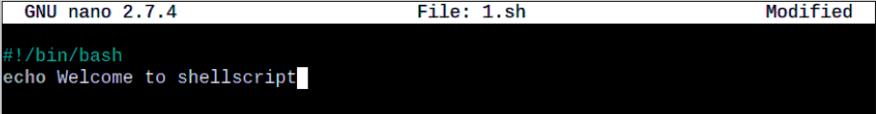

Sample shell script

Slide 23

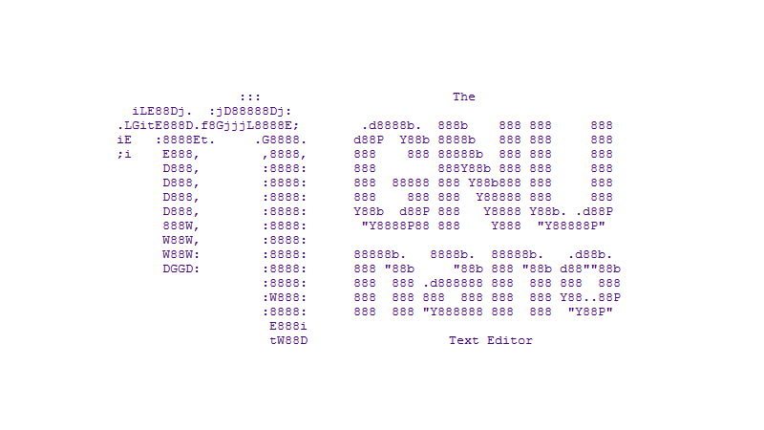

Text editors

Slide 24
File Permissions

Slide 25

Linux Users
Users Groups Others/Processes
Every user has their own directory, usually within /home/username

Slide 26
Linux Users
Users
Owner of file.
System uses User IDs (UID) to manage users.
System identifies process a users.

Slide 27
Linux Users
Groups
Contain 2 or more users.
All users in the group have same permissions as given to the group.
Group are identified using GID.

Slide 28
Linux Users
Others
A process can open a file and even read or write in file.
If a process is using a file and we deleted it, it does not get “deleted”.
Effective UID Real user UID Saved user UID.

Slide 29
File permission commnds
who
w
useradd
groupadd
USER
GROUP
OTHERS
- | r | w | - | r | - | - | r | - | -
Type | Read | Write | Execute | Read | Write | Execute | Read | Write | Execute
d
-
r
-
w
-
x
-

